Slide 1
Lecture 5 CUDA Memory Architecture
Kyu Ho Park
Mar. 14, 2017

Slide 2
CUDA Memory Architecture
Grid
Block 0
Block 1
공유메모리
(Shared Memory)
공유메모리
(Shared Memory)
Register
Register
Register
Register
Thread 0
Thread 1
Thread 0
Thread 1
Host
Global Memory
Constant Memory
Texture Memory

Slide 3
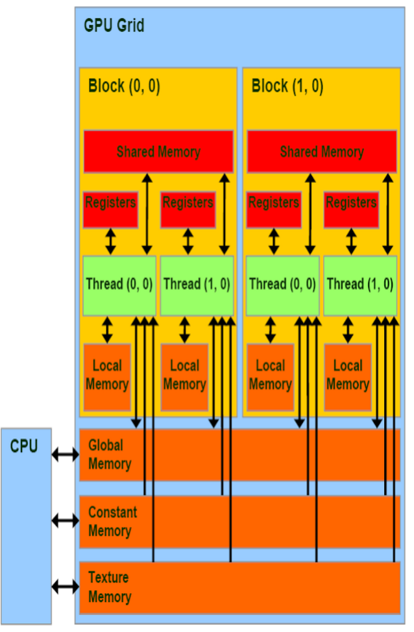

Slide 4
CUDA Memory Characteristics
Registers : RW a thread
Local Memory : RW a thread
Shared Memory : RW all threads in a block
Global Memory : RW all threads in a device(grid) and the host
Constant Memory : R all threads in a device and the host
Texture Memory : R all threads in a device and the host

Slide 5
Registers
An automatic variable is a local variable which is allocated and deallocated automatically when program flow enters and leaves the variable's scope.
An automatic variable declared in a kernel without any other type qualifiers is stored in a register.
Arrays declared in a kernel may be stored in registers. (but only if the indices used to reference the array are constant and can be determined at compile time. )
A kernel uses registers to hold frequently accessed thread-private variables.
Fermi: limit of 63 registers per thread,
Kepler: 255 registers per thread.
Register are partitioned among threads
If a kernel uses more registers than the hardware limit, the excess registers will spill over to local memory. This register spilling can have adverse performance consequences

Slide 6
Memory Hierarchy
Speed
Size
Fastest(~2ns)
Registers
Caches(Primary,Secondary)
Main Memory
Disk Memory
smallest
(~4ns, ~30ns)
~220ns
Slowest( 1~6ms)
biggest

Slide 7
Locality of Memory Access
Temporal locality: If at one point a particular memory location is referenced, then it is likely that the same location will be referenced again in the near future
Spatial locality: If a particular memory location is referenced at a particular time, then it is likely that nearby memory locations will be referenced in the near future

Slide 8
Local Memory
Local arrays referenced with indices whose values cannot be determined at compile time.
Large local structures or array that would consume too much register space.
Any variable that does not fit within the kernel register limit.
Local memory is actually a part of Global memory that has high latency and low bandwidth and are subject to the requirements for efficient memory access.
With compute capability 2.0 and higher, local memory data is also cached in a per-SM L1 and per-device L2cache

Slide 9
Local Memory(LMem)
When too many registers are used,
too many local variables are used,or local variables are arrays, local memory is allocated.
LMem is actually a part of Global Memory(GMem).
compiler option: -maxrregcount=32
//it limits the number of registers 32 per thread.

Slide 10
Shared Memory(SMem)
On Chip memory,
Partitioned among thread blocks resident on the SM
access speed is the same as the L1 cache(but is also programmable)
the size is 16KiB per SM, and easily used by CUDA.
static allocation
__shared__ int a[1024];
dynamic allocation
extern __shared__ int b[ ];

Slide 11
SMem Read/Write
__global__ void LoadStoreSharedMemory(int *In, int *Out)
{
__shared__ int SharedMemory[512];
SharedMemory[threadIdx.x]=In[threadIdx.x];
__syncthreads( );
Out[threadIdx.x]=SharedMemory[threadIdx.x];
__syncthreads();
}
int main()
{
…..
LoadStoreSharedMemory<<<1,512>>>(dev_In,dev_Out);
….
return 0;
}

Slide 12
Synchronization
A synchronization barrier enables multiple threads to wait until all threads have all reached a particular point of execution before any thread continues.
CUDA allows threads in the same block to coordinate their activities using a barrier synchronization function,
__syncthreads() .

Slide 13
__syncthread()
A __syncthread() must be executed by all threads in a block. (they should __syncthread() at the same instruction address)
What will happen? ! not correct the instruction addres different!!!!!!
if( ) then{ A;
__syncthread();}
else {B;
__syncthread();}

Slide 14
__syncthread()
The CUDA can execute blocks in any order relative each other because none of them must wait for each other.

Slide 15
Global Memory(GMem)
GMem: DRAM at a Graphic Card.
GMem bandwidth: GPU uses 32Bytes,64Bytes or 128Bytes memory I/O (transaction)
Declared dynamically GMem allocation and deallocation:
cudaError_t cudaMalloc(void ** devPtr, size_t count);
cudaErroe_t cudaFree(void* devPtr);
Declared statically
__device__
Memory copy
cudaError_t cudaMemcpy(void* dst, const void*src, size_t count, cudaMemcpyKind kind);

Slide 16
Constant Memory(CMem)
CMem:
some part of DRAM is used for CMem ,and it is read only and Cache is supported (constant cache).
The max size is 64kB.
The host can write Cmem and the device can read it only.
All threads can share it like the global memory.
Constant variables must be declared with global scope, outside of any kernels. Constant memory is statically declared and visible to all kernels in the same
compilation unit
Constant memory performs best when all threads in a warp read from the same memory address
__constant__ int cData[6];
int hData[6] = {1,2,3,4,5,6};
cudaMemcpyToSymbol(“cData”,&hData,sizeof(hData));

Slide 17
Constant Memory(CMem)
Constant memory performs best when all threads in a warp read from the same memory address. For example, a coeffcient for a mathematical formula is a good use case for constant memory because all threads in a warp will use the same coeffcient to conduct the same calculation on different data.
If each thread in a warp reads from a different address, and only reads once, then constant memory is not the best choice because a single read from constant memory broadcasts to all threads in a warp.

Slide 18
Texture Memory
It is in device memory and is cached in a per-SM, read-only cache.
Texture memory is a type of global memory that is accessed through a dedicated read-only cache.
It is optimized for 2D spatial locality.
texture memory is another variety of read-only memory that can improve performance and reduce memory traffic when reads have certain access patterns
texture memory is cached on chip
so in some situations it will provide higher effective bandwidth by reducing memory requests to off-chip DRAM
texture caches are designed for graphics applications where memory access patterns exhibit a great deal of 2D spatial locality

Slide 19
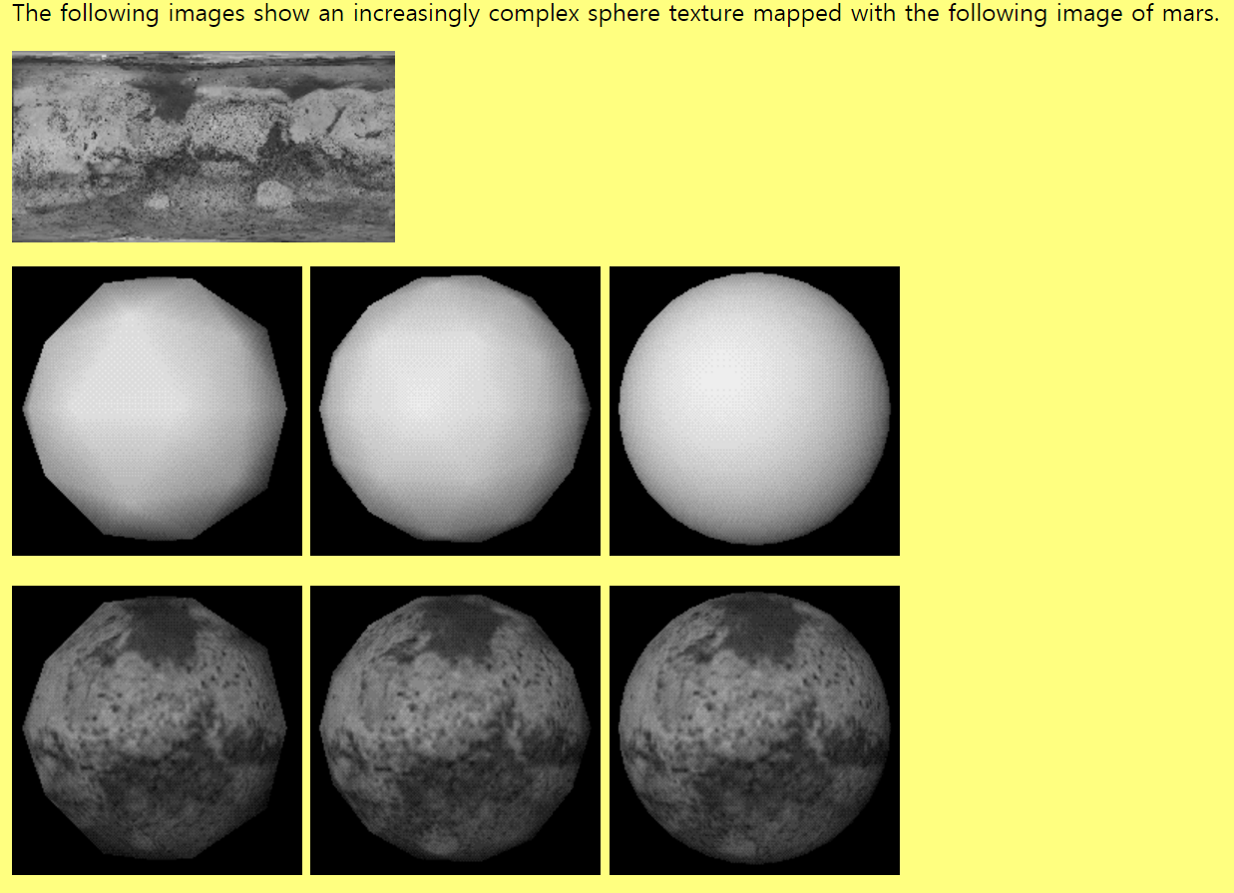
Texture
XX

Slide 20
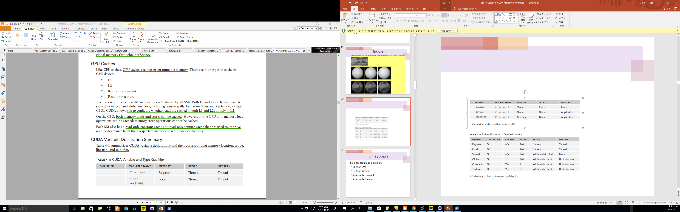
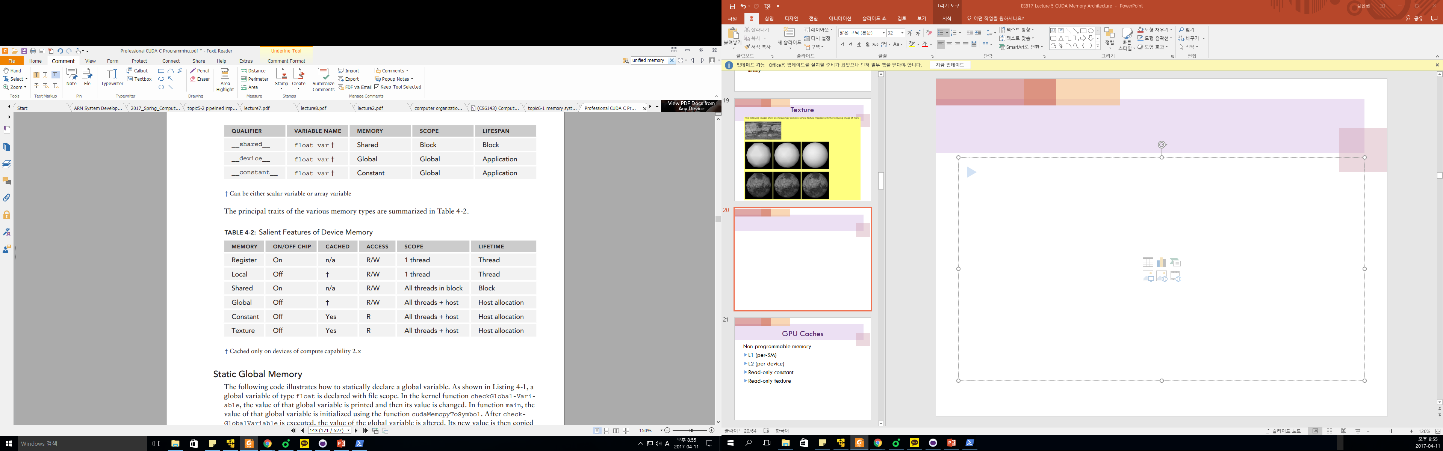

Slide 21
GPU Caches
Non-programmable memory
L1 (per-SM)
L2 (per device)
Read-only constant
Read-only texture

Slide 22
Global Variable
cudaMemcpyToSymbol(devData, &value, sizeof(float));
cudaMemcpyFromSymbol(&value, devData, sizeof(float));
-These are CUDA runtime API,
-devData is passed as a symbol,
-In the kernel, devData is used as variable in global memory.
The address of a global variable can be acquired by the CUDA API following;
float *dptr=NULL;
cudaGetSymbolAddress((void**)&dptr,devData);
cudaMemcpy(dptr, &value, sizeof(float),cudaMemcpyHostToDevice);

Slide 23
Global Memory Allocation, Deallocation, Transfer
cudaError_t cudaMalloc(void **devPtr, size_t count);
cudaError_t cudaMemset(void *devPtr, int value, size_t count);
cudaError_t cudaFree(void *devPtr);
cudaError_t cudaMemcpy(void *dst, const void *src, size_t count, enum cudaMemcpyKind kind);

Slide 24
CPU and GPU Memory
CPU
CPU Memory
25GB/sec
8GB/sec
pcie
GPU
GPU Memory
144GB/sec

Slide 25
Pinned Memory
All host memory is pageable by default, since the host memory is managed by virtual memory system of OS.
The GPU cannot safely access data in pageable host memory because it has no control over when the host OS may choose to move that data.
To transfer data from pageable host memory to device memory, CUDA first allocates temporary page-locked (pinned) memory , copies the source host data to pinned memory and then transfers the data from pinned memory to device memory.

Slide 26
Paging Model of Logical and Physical Memory
frame
number
page 0
page 1
page 2
page 3
0
1 | page 0
2
3 | page 2
4 | page 1
5
6
7 | page 3
0 | 1
1 | 4
2 | 3
3 | 7
page table
logical
memory
physical
address

Slide 27
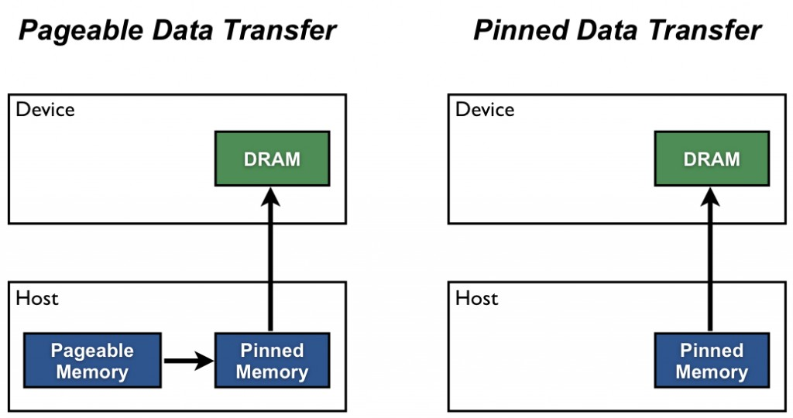
Pinned Memory

Slide 28
Allocation of pinned host memory
cudaError_t cudaMallocHost(void **devPtr,size_t count);
Example:
cudaError_t status=cudaMallocHost((void**))&h_aPinned,bytes);
if(status !=cudaSuccess){
fprint(stderr,”Error returned from pinned host memory allocation\n”);
exit(1);}
//pinned memory release
cudaError_t cudaFreeHost(void *ptr);

Slide 29
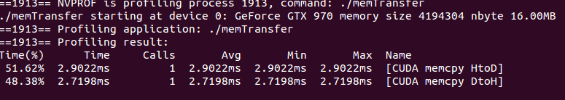
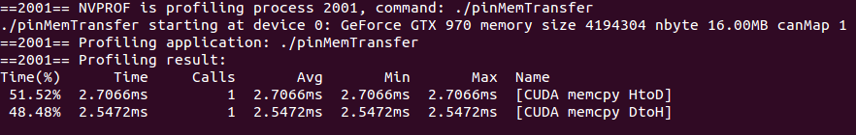
performance
memTransfer
pinMemTransfer

Slide 30
Zero-Copy Memory
Between a host and the device,
Host cannot directly access device variables,
The device cannot directly access host variables.
In Zero-Copy Memory,
They provide ‘zero-copy memory’, and both the host and device can access it.

Slide 31
Zero-Copy Memory
The host memory can be used when there is insufficient device memory,
Explicit data transfer is not necessary between the host and device,
Zero-copy memory is pinned(non-pageable)memory that is mapped into device address space.

Slide 32
Zero-Copy Memory
cudaError_t cudaHostAlloc(void **pHost, size_t count, unsigned int flags); //Alocates ‘count’bytes of host memory that is page-locked and accessible to the device. the access speed is very slow because it use the pcie (the bandwidth of pcie is very slow than any device memory)
flags :
cudaHostAllocDefault
cudaHostAllocPortable :
cudaHostAllocWriteCombined
cudaHostAllocMapped : returns host memory that is mapped into device address space.

Slide 33
Zero-Copy Memory
__global__ void sumArraysZeroCopy(float *A, float *B, float *C, const int N){
int i=blockIdx.x * blockDim.x + threadIdx.x;
if( i<N) C[i] = A[i] + B[i];
}
//Allocate A,B as zero-copy memory and C in device memory.

Slide 34
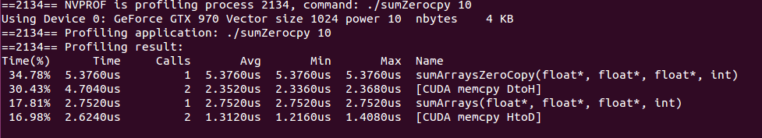
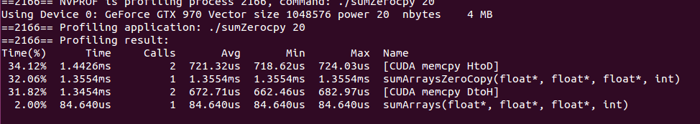
Zero-Copy Memory

Slide 35
Issues of Zero-Copy Memory
It simplifies programming.
For large data set shared by CPU and GPU that are connected by PCIe bus, it would be a poor choice.
There could be racing problem.

Slide 36
Unified Virtual Addressing
Introduced in CUDA 4.0
0x0000
0xFFFF
0
CPU Memory
GPU0
Memory
GPU1
Memory
CPU
GPU0
GPU1
With UVA, host memory and device memory share a single virtual address Space.
Prior to UVA, you needed to manage which pointers referred to host memory and which referred to device memory. Using UVA, the memory space referenced by a pointer becomes transparent to application code

Slide 37
Unified Memory (CUDA 6.0)
Unifed Memory creates a pool of managed memory, where each allocation from this memory pool is accessible on both the CPU and GPU with the same memory address (that is, pointer). The underlying system automatically migrates data in the unified memory space between the host and device.
Managed memory refers to Unified Memory allocation that are automatically managed by the underlying system.
__device__ __managed__ int y;//This variable can be referenced directly from either host or device code.
cudaError_t cudaMallocManaged(void **devPtr, size_t size, unsigned int flags=0);//the host can use this.
This function allocates size bytes of managed memory and returns a pointer devPtr. The pointer is valid on all devices and the host.

Slide 38
Memory Access Patterns
Most device data access begins in global memory, therefore the performance of GPU might be limited by the memory bandwidth.
Maximizing the use of global memory bandwidth is the fundamental step.

Slide 39
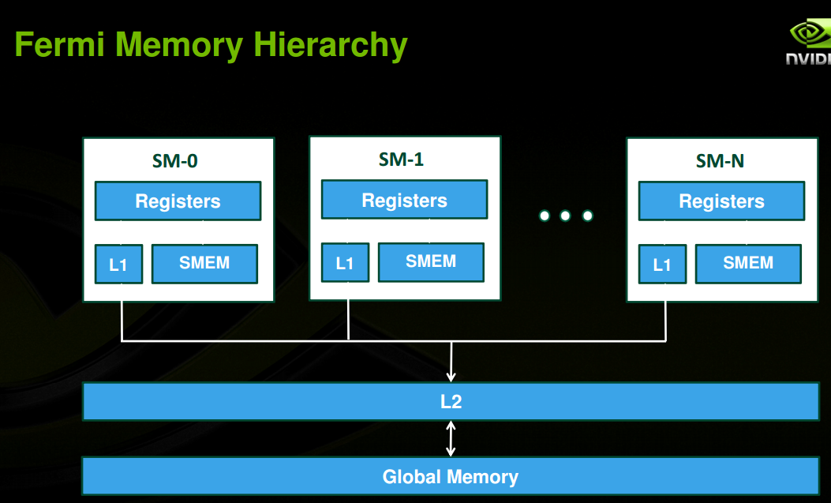
Memory Hierarchy

Slide 40
Memory Access
All accesses to global memory are through the L2 cache.
If L1 and L2 caches are used , a memory access is served by a 128-byte memory transaction.
If only L2 cache is used, a memory access is serviced by a 32-byte memory transaction. (disable L1 cache)
A L1 cache line is 128 bytes and it maps to a 128-byte aligned segment in device memory.
If each thread in a warp requests 4-byte value, that results in 128 bytes per request. It maps perfectly to the cache line size and device memory segment size.

Slide 41
Two Characteristics of Memory Access
Aligned memory access:
The first address of a device memory transaction is an even multiple of the cache granularity, that is, 32-byte for
L2 cache or 128 bytes for L1 cache.
misaligned load will cause wasted bandwidth
Coalesced memory access:
All 32 threads in a warp access a contiguous chunk of
memory.

Slide 42
Aligned and Coalesced memory Access
Memory Address
128
256
Memory
threadId
0
31
misaligned and uncoalesced access
threadId
0
31

Slide 43
Global Memory Reads
In an SM, 3 data paths:
1.L1/L2 cache
2.Constant cache
3.Read-only cache
L1 cache is enabled for global memory loads on Fermi devices and disabled on K40 and later GPUs.
Compiling with -Xptxas –dlcm=cg to disable L1.
Enabling L1: -Xptxas dlcm=ca
Explicit management needed

Slide 44
Cached(L1) Load
L1-cached load operations are serviced at the granularity of an L1 cache line, 128-bytes.
Each thread requests a 4-byte at a time.

Slide 45
Cached Loads
Addresses from a warp
Global memory
128
256
Aligned? o Coalesced? o How many memory transaction? 1
bus utilization 100%

Slide 46
Cached Loads
Addresses from a warp
Global Memory
128
256
Access is aligned and randomized within 128 bytes range . (not coalesced)
How many 128-byte transaction is needed? 1
buss utilization 100%

Slide 47
Cached Loads
Addresses from a warp
Global memory
128
256
Aligned? X Coalesced? O
How many 128-bytes transactions are required? 2
bus utilization 50%

Slide 48
Cached Loads
Addresses from a warp
Global Memory
128
256
All threads in the request the same address.
How many 128-bytes transactions are required? 1
Bus utilization? 4/128 %

Slide 49
Cached Loads
Addresses from a warp
Global Memory
128
256
Threads in a warp request 32 four bytes addresses scattered all over the global memory.

Slide 50
DIFFERENCE BETWEEN CPU L1 CACHE AND GPU L1 CACHE
The CPU L1 cache is optimized for both spatial and temporal locality.
The GPU L1 cache is designed for spatial but not temporal locality.
Frequent access to a cached L1 memory location does not increase the probability that the data will stay in cache.

Slide 51
Uncached Loads
Uncached loads are performed at the granularity of 32-byte memory segments.
At compile time, use
-Xptas –dlcm=cg for L1 cache diabled.

Slide 52
Uncached Loads
Addresses from a warp
Global Memory
128
160
192
224
256
Aligned and coalesced memory access
How many 128-bytes transactions are required? 4
Bus utilization 100%

Slide 53
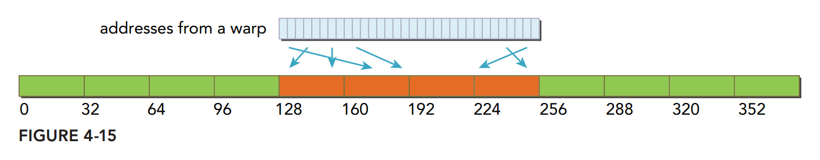
Uncached Loads
Aligned and non-coalesced memory access
How many 128-bytes transactions are required? 1
Bus utilization 100%

Slide 54
Uncached Loads
Addresses from a warp
segment
Global Memory
64
96
128
160
192
224
256
All threads in a warp requests 32 consecutive 4-bytes data but the load is not aligned to a 128 byte boundary
All accesses fall within 5 segments.
The addresses for the 128 bytes requested fall within at most five segments, and bus utilization is at least 80 percent.
Performance is improved with uncached loads compared to cached loads for these types of requests because fewer unrequested bytes are loaded.

Slide 55
Uncached Loads
Addresses from a warp
Global Memory
128
160
192
224
256
All accsses request the same data.

Slide 56
Misaligned Read
__global__ void readOffset (float *A, float *B, float *C, const int n, int offset) {
unsigned int i=blockIdx.x * blockDim.x + threadIdx.x;
unsigned int k= i + offset;
if( k<n) C[i] =A[k] + B[k];
}

Slide 57
Global Load Efficiency gld_efficiency
gld_efficiency =
(Requested Global Memory Load Throughput)/
(Required Global Memory Load Throughput)

Slide 58
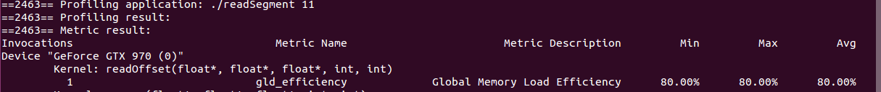
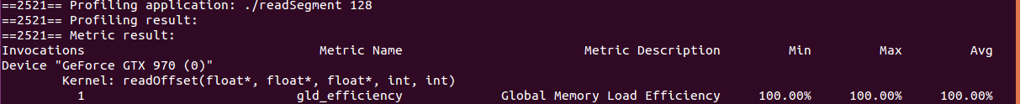
$nvprof –metrics gld_transactions ./readSegment 0

Slide 59
Global Memory Writes
L1 cache is not used for store operations.
L2 cache is used before being sent to device memory. (global memory)
Store operation is performed at a 32-byte segment granularity.
Memory transactions can be one, two, or four segments at a time!

Slide 60
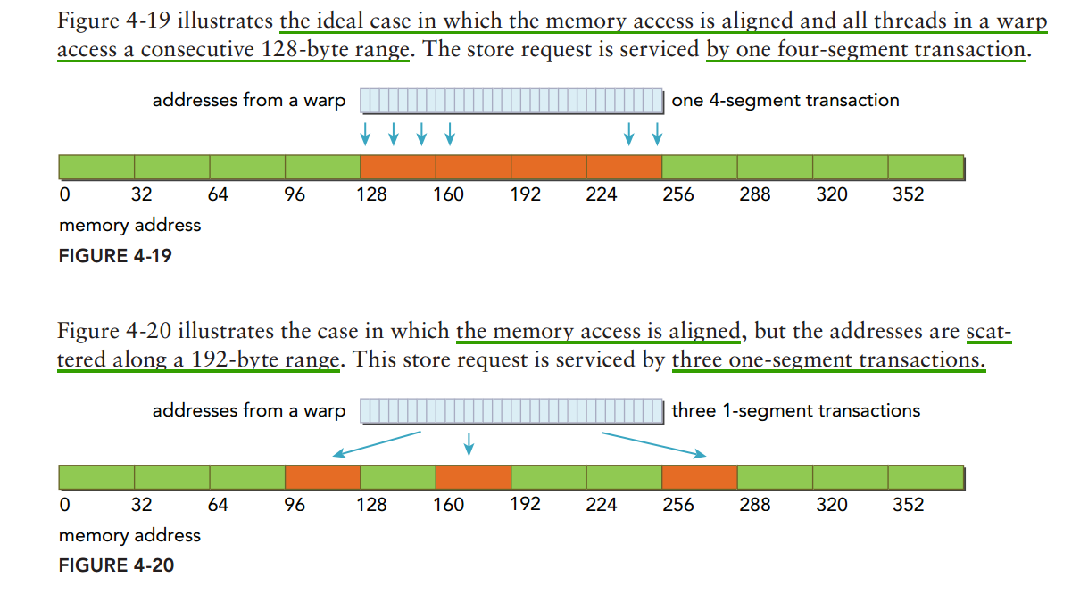
Global Memory Writes

Slide 61
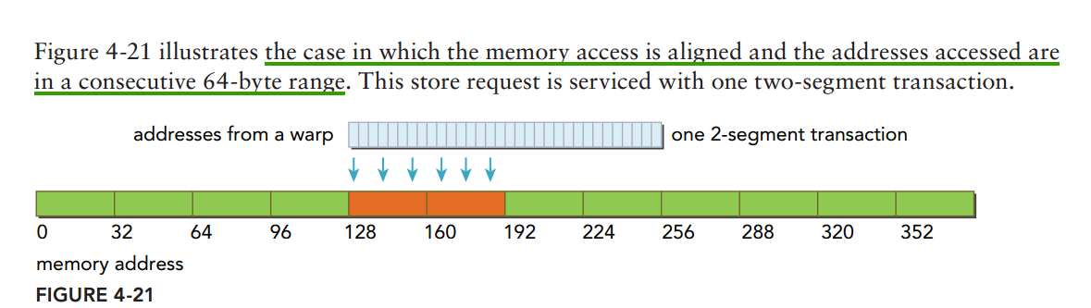
Global Memory Writes

Slide 62
gst_efficiency
gst_efficiency: global store effriciency.
--global__ void writeOffset(float *A, float *B, float *C, const int n, int offset){
unsigned int i=blockIdx.x * blockDim.x + threadIdx.x;
unsigned int k=i+offset;
if(k<n) C[k]=A[i] + B[i];
}
$nvprof --metrics gst_efficiency --metrics gld_efficiency ./writeSegment 11
offset value

Slide 63
Global Memory Writes
Addresses from a warp
Global Memory
128
160
192
224
256
Accesses are aligned and the addresses accessed are in a consecutive 64-byte(2 segments) range.

Slide 64
Array of Structure , Structure of Array
Array of Structure(AOS)
struct innerStruct {
float x;
float y;
}
struct innerStruct myAoS[N];
Structure of Array(SOA)
struct innerArray{
float x[N];
float y[N];
}
struct innerArray mySOA;

Slide 65
AOS and SOA
AOS Memory Layout
x | y | x | y | x | y | x | y | x | y
t0
t1
t2
t3
t4
SOA Memory Layout
x | x | x | x | x | y | y | y | y | y
t0
t1
t2
t3
t4

Slide 66
Unrolling loops
__global__ void readOffset(float *A, float *B, float *C, const int n, int offset) {
unsigned int i=blockIdx.x * blockDim.x + threadIdx.x;
unsigned int k= i + offset;
if( k<n) C[i] =A[k] + B[k];
}
__global__ void readOffsetUnroll4(float *A, float *B, float *C, const int n,
int offset){
unsigned int i=blockIdx.x*blockDim.x *4 + threadIdx.x;
unsigned int k = i + offset;
if(k+3*blockDim.x<n) {
C[i]=A[k];
C[i + blockDim.x] =A[k+blockDim.x] + B[k+blockDim.x];
C[i+ 2*blockDim.x]=A[k+2*blockDim.x]+B[k+2*blockDim.x];
C[i+ 3*blockDim.x]=A[k+3*block*Dim.x]+B[k+3*blockDim.x];
}
}

Slide 67
Matrix Transpose
0 | 4 | 8
1 | 5 | 9
2 | 6 | 10
3 | 7 | 11
0 | 1 | 2 | 3
4 | 5 | 6 | 7
8 | 9 | 10 | 11
Matrix
Transposed Matrix

Slide 68
Presentation Schedule 2 on 23 Mar., 2017
Mr. 기세환
Image Processing with CUDA, Jia Tse,2006.
Mr. 정휘영
Image Convolution with CUDA, Victor Podlozhnyuk, 2007.
*Send your presentation file to
TA Mr.Kim Woo Joong, PhD Student(w.j.kim@kaist.ac.kr) before your presentation to upload it to the Web.
*Homework#2 will be issued on 16 Mar. 2017

